Slide 1
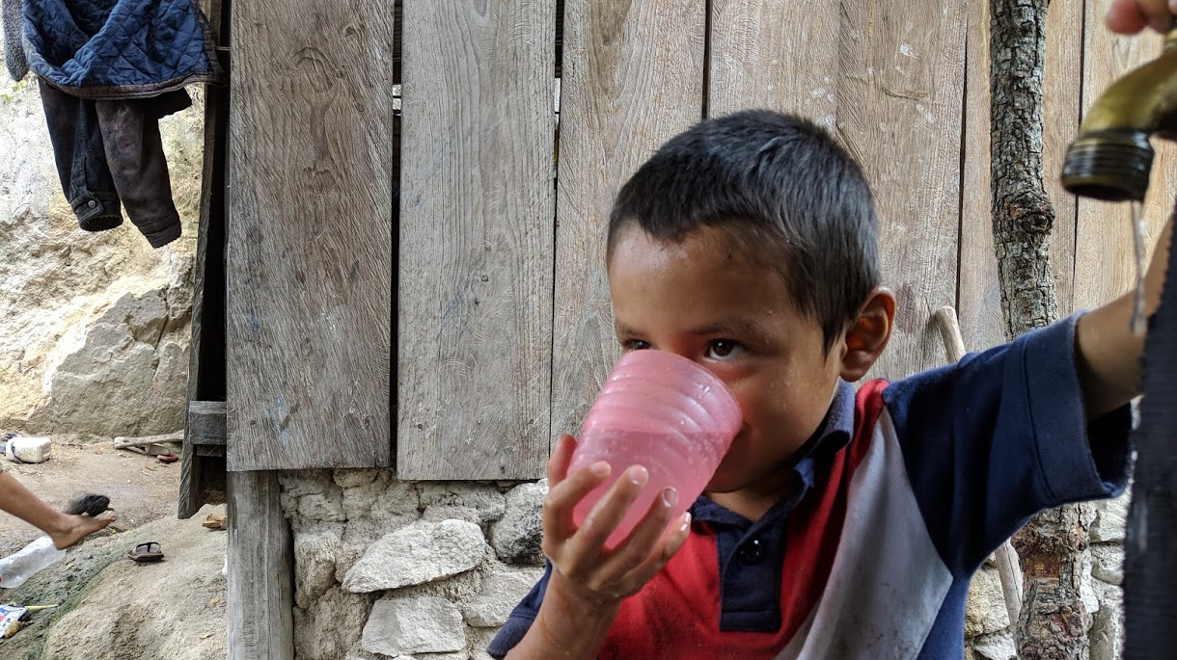
Introduction
Monroe L. Weber-Shirk
AguaClara Reach
Notes:
Photo credit to Yitzy Rosenburg, 2019
Add expectation that student come to class!

Slide 2

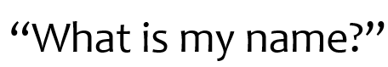
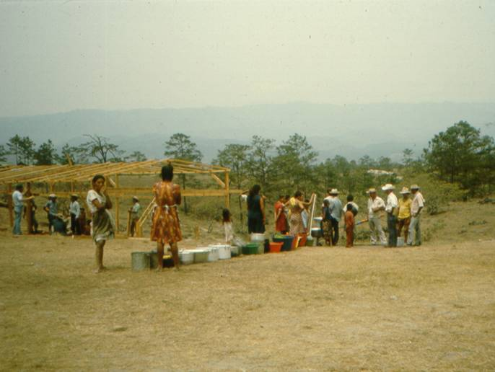
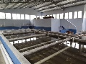

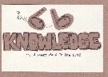
Overview
Creativity
What is this course about?
Course Organization
Introductions
Why am I teaching this course?
A search for truth that matters
Groupthink: avoiding the truth
Myth in engineering
The Challenge
It is a short walk to the edge of knowledge
Respect
AND question!
Don’t believe
everything I say
Ctrl + click the pictures to go each section!
Notes:
Add about OSU and the ACR connections

Slide 3
Overview
Creativity
What is this course about?
Course Organization
Introductions
Why am I teaching this course?
A search for truth that matters
Groupthink: avoiding the truth
Myth in engineering
The Challenge
It is a short walk to the edge of knowledge
Respect
AND question!
Don’t believe
everything I say
Ctrl + click the pictures to go each section!

Slide 4
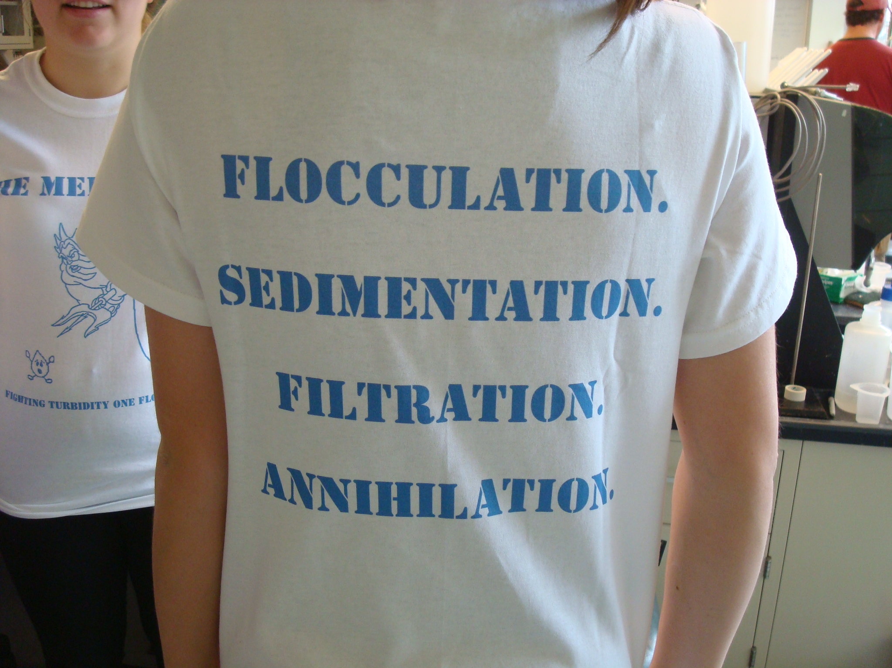
What is this course about?
Creative thinking about solutions to the enormous challenge of providing safe water on tap to communities everywhere
We will challenge the myth that this task can be accomplished by applying traditional technologies and we will identify opportunities for new insights
We will be introduced to the new field of sustainable drinking water treatment
My thesis is that engineers are needed to challenge existing assumptions and to create and document new sustainable solutions
We will practice design thinking using the best available design tools

Slide 5
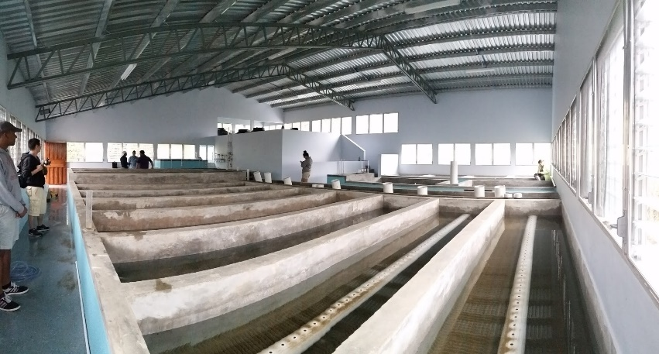
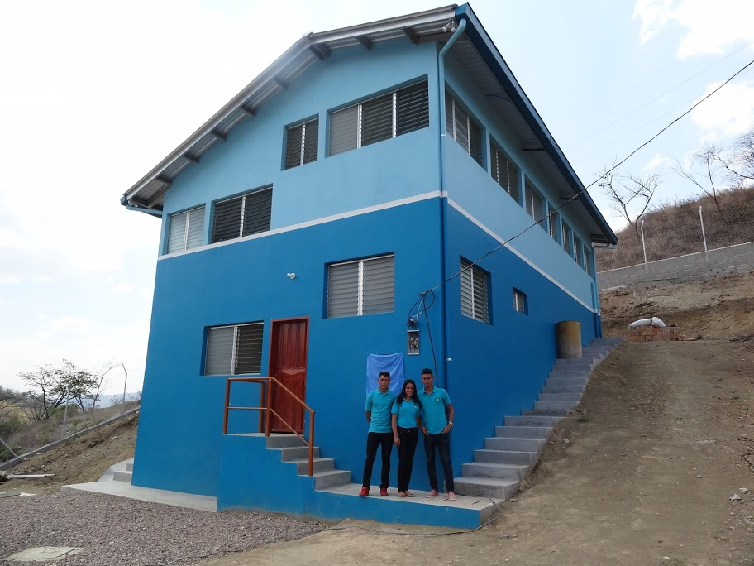
My Goal for this course is to provide a safe learning environment where
each of you can develop a fundamental understanding of the processes that control the performance of each of the drinking water treatment steps
each of you experiences the power of using constraints, physics, and the goal of sustainability to guide the design of infrastructure

Slide 6

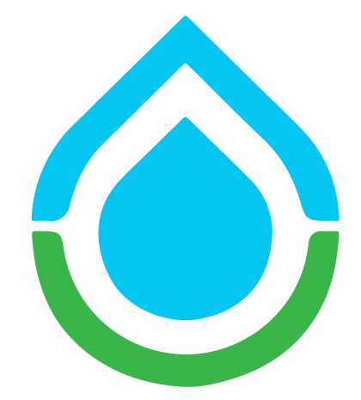
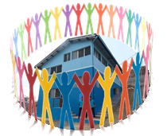


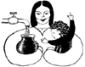
This course is part of the AguaClara Ecosystem: designed for innovation and collaboration
Supporters Volunteers
RIDE
University Research
Insights and problems from Partners
Designs, technical support, and best practices
Water Ministry, Development Banks, etc
Community water boards
Implementation Partners
Notes:
AguaClara Reach is a node in the growing AguaClara network

Slide 7
Course expectations
Come to class ready to learn, share your video if possible, and be present!
We are learning with you
I am in the process of updating the lecture notes (we continue to learn about water treatment)
The assignments are all new this year (we are using better tools)
You will undoubtedly discover something that doesn’t work as you expected. What should you do WHEN that happens?
Email Patrick, Clare, and me

Slide 8
Overview
Creativity
What is this course about?
Course Organization
Introductions
Why am I teaching this course?
A search for truth that matters
Groupthink: avoiding the truth
Myth in engineering
The Challenge
It is a short walk to the edge of knowledge
Respect
AND question!
Don’t believe
everything I say
Ctrl + click the pictures to go each section!

Slide 9
Design Challenges
How do you learn?
Why teams?
Drafts and final submission
Teaching Assistant (Clare O’Conner)
Onshape!
Notes:
Play!
Sense of timelessness (time doesn’t matter)
Y

Slide 10
Why Onshape?
Tools matter!
If something is hard then it is likely that you aren’t using the right tool
We have used a series of design tools
Mathcad linked to AutoCAD - handles units but was difficult to modify the geometry
Python – Open source tool for hydraulic design work that handles units. Not integrated with 3d modeling.
Onshape – Integrates hydraulic design and 3d modeling

Slide 11
Overview
Creativity
What is this course about?
Course Organization
Introductions
Why am I teaching this course?
A search for truth that matters
Groupthink: avoiding the truth
Myth in engineering
The Challenge
It is a short walk to the edge of knowledge
Respect
AND question!
Don’t believe
everything I say
Ctrl + click the pictures to go each section!
Ctrl + click the pictures to go each section!

Slide 12
Why am I teaching this course?
Experience in refugee camps in Honduras in 1982-83
The spark of interest: What makes slow sand filters work? (no one knew!)
Invitation to begin a water project in Latin America (12/2002)
The realization that what I had been taught wasn’t up to the challenge of solving the big global challenge of providing safe drinking water on tap to communities
16th time teaching this course – changes every time!
Notes:
Realization that we were assuming that knowing how to build water treatment facilities in the US prepared students for tackling the problem anywhere on the planet.
Issues of scale and resources (human, capital)

Slide 13
Mesa Grande: Waiting for water

Slide 14
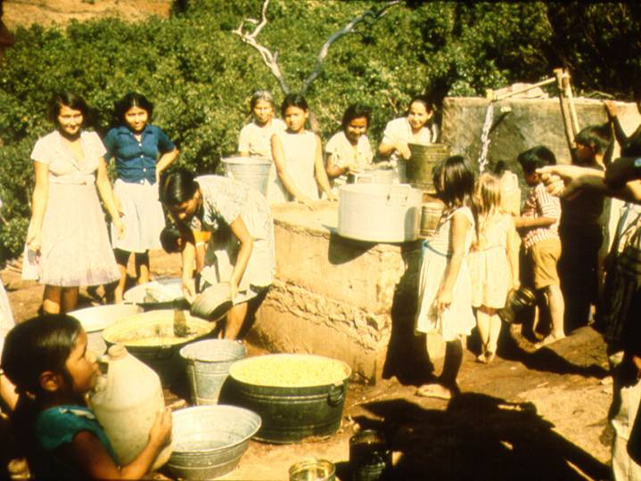
Water in Colomoncagua

Slide 15
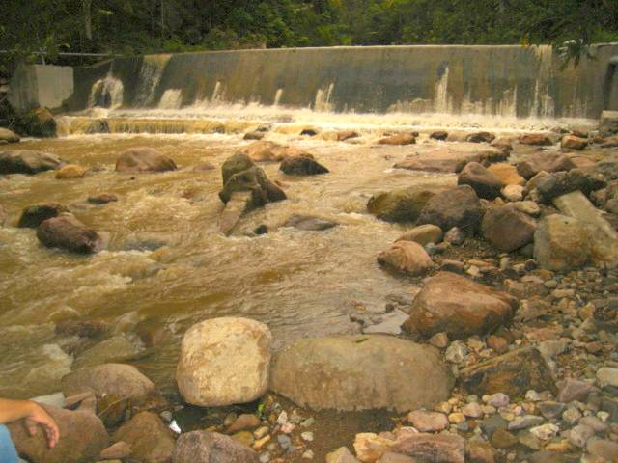

Slide 16
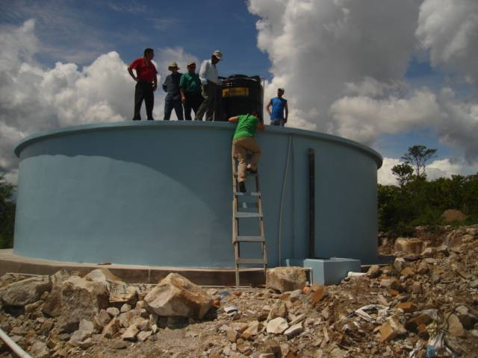

Slide 17
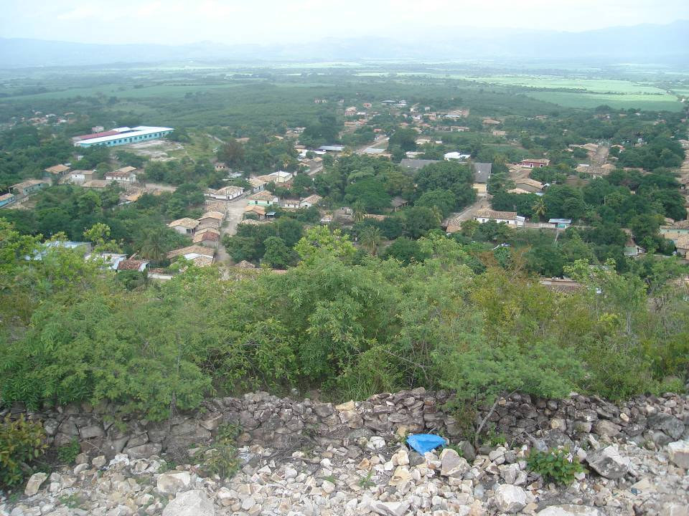

Slide 18
Overview
Creativity
What is this course about?
Course Organization
Introductions
Why am I teaching this course?
A search for truth that matters
Groupthink: avoiding the truth
Myth in engineering
The Challenge
It is a short walk to the edge of knowledge
Respect
AND question!
Don’t believe
everything I say
Ctrl + click the pictures to go each section!
Ctrl + click the pictures to go each section!

Slide 19
You should be taking a course in business or information technology
Environmental engineers have been applying the same drinking water solutions for the past 100 years
The science behind environmental engineering is already well understood
Providing everyone on the planet with safe drinking water only requires the money and political will to apply known technologies
Discussion time! Do you agree?
Notes:
Dead: no! We need to be playing a major role in improving public health and in protecting the environment from human waste and
Already understood: Many things are well understood. Others need much more research (coming up)
Same solutions: Many of our solutions are 80 years old. But our 80 year old solutions haven’t provided everyone with decent water and sanitation. So we need new solutions that can be implemented where the constraints are more severe.
Known technologies: Same as previous argument. The known technologies may not be the best solution to the new types of problems we are trying to solve. And every situation requires a new assessment of which technologies are best.

Slide 20
Uneven Knowledge Space
nanotechnology
Water purification
WMD
pharmaceuticals
Learn from adjacent knowledge spaces!
Notes:
Much to learn
The potential for improving the well being of humans and of the planet is enormous
The challenge: to make the same progress in water supply as we are making in the hot sciences.
Nano technology is really cool. Nanotechnology isn’t going to provide the world with safe drinking water, food, or transportation networks. Some engineers should definitely explore nanotechnologies. More engineers should develop efficient and sustainable infrastructure for a healthy society.
This is science that is directly connected to the messiness of the real world. The problems can’t be solved exclusively in the lab (although there are many technical challenges that need laboratory investigations).

Slide 21
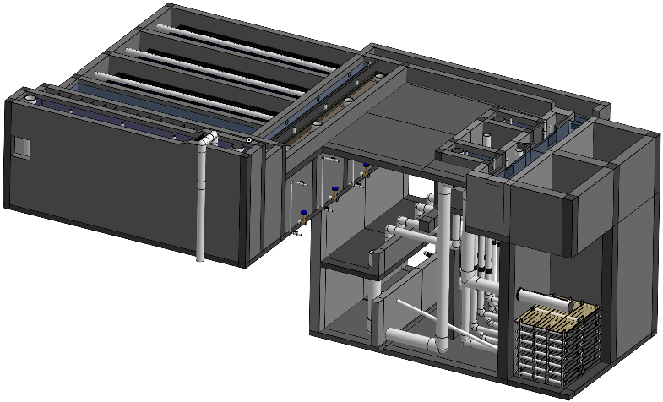
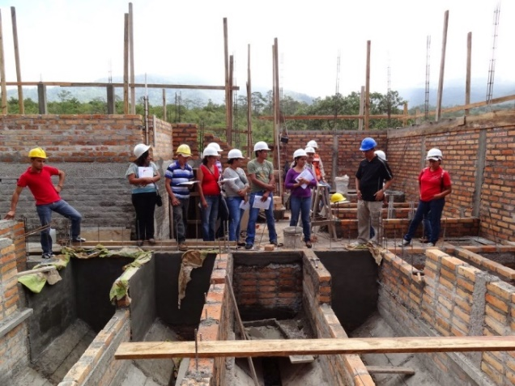
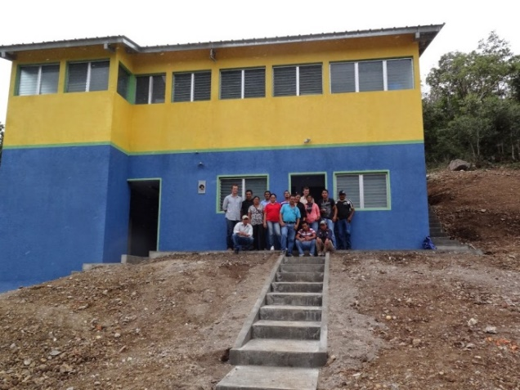

A Search for Truth that Matters
AguaClara is creating new technologies, improving old technologies, and developing the design algorithms for surface water treatment plants of any size
Math – Physics – Fluid Mechanics – Chemistry – Geometry - Economics
Notes:
The amazing ability to represent reality symbolically

Slide 22
Overview
Creativity
What is this course about?
Course Organization
Introductions
Why am I teaching this course?
A search for truth that matters
Groupthink: avoiding the truth
Myth in engineering
The Challenge
It is a short walk to the edge of knowledge
Respect
AND question!
Don’t believe
everything I say
Ctrl + click the pictures to go each section!
Ctrl + click the pictures to go each section!

Slide 23
Groupthink
Groupthink refers to faulty decision-making in a group (coined by Irving Janis, 1972)
Groups experiencing groupthink do not consider all alternatives and they desire unanimity at the expense of quality decisions
Irving, Janis. (1972). Victims of groupthink. Boston: Houghton Mifflin; Irving, Janis. (1982). Groupthink: Psychological studies of policy decisions and fiascos. 2nd ed. Boston: Houghton Mifflin.

Slide 24
Some Solutions to Groupthink
Admit that you don’t know everything!
Encourage honesty!
Question everything
Be alert to technical jargon that doesn’t mean anything
Check with outside experts
Hold a "second-chance meeting" to offer one last opportunity to choose another course of action
Notes:
http://www.abacon.com/commstudies/groups/groupthink.html
Create a climate where disagreement is welcomed

Slide 25
How might Environmental Engineers fall into the trap of groupthink?
I don’t want to discover that my technology is obsolete and that the years of effort that I put into improving that technology have been a waste
Confusion of confidence and scientific proof
Reliance on empiricism rather than physics
Confusion of the ability to name a process (Flocculation) with an understanding of the physics of the process
Reduce “groupthink” by… ________________________________________
Creating a safe environment for questions and for learning!
Notes:
Dissenters are stupid
We are too often operating under the assumption that the person in the front of the room knows everything and the student role is to soak up the knowledge.
As the problems become more complex with multiple objectives the need to explore alternatives becomes very important.
Disagreements are encouraged!
Always look for the evidence and assess the evidence yourself. Beware of poorly substantiated conclusions.

Slide 26
Overview
Creativity
What is this course about?
Course Organization
Introductions
Why am I teaching this course?
A search for truth that matters
Groupthink: avoiding the truth
Myth in engineering
The Challenge
It is a short walk to the edge of knowledge
Respect
AND question!
Don’t believe
everything I say
Ctrl + click the pictures to go each section!
Ctrl + click the pictures to go each section!

Slide 27
Role of Myth in Environmental Engineering
Myth can be a useful way of understanding a complex reality
creation stories
Myth can also be used to describe generally accepted but unproven hypotheses (my usage here)
Myth #1: Science and engineering aren’t influenced by myth because they are based on the scientific method

Slide 28
Historic Examples of Myth
Malaria (bad air disease hypothesis)
Streams purify themselves in 1 mile
The air coming out of the ground under conditions of low or sinking groundwater causes typhoid
Chlorine eliminated typhoid in the United States
Notes:
http://www.sciencedirect.com/science?_ob=MImg&_imagekey=B6V73-45FSRSX-1-K&_cdi=5831&_orig=browse&_coverDate=09/30/2002&_sk=999639984&view=c&wchp=dGLbVtb-zSkzS&_acct=C000022719&_version=1&_userid=492137&md5=fffe3104bff87c2e91320230a4a97810&ie=f.pdf
Our explanations for natural phenomena matter. How would you keep your child safe from air coming out of the ground under conditions of low or sinking groundwater?

Slide 29
Expose the Myth
Let’s expose some more environmental engineering myths
Don’t believe everything I say
You should always be asking:
How do we know that?
Why can’t we do this better?
There are many things that I have taught in this class in previous years that I now know are wrong or incomplete understandings

Slide 30
Overview
Creativity
What is this course about?
Course Organization
Introductions
Why am I teaching this course?
A search for truth that matters
Groupthink: avoiding the truth
Myth in engineering
The Challenge
It is a short walk to the edge of knowledge
Respect
AND question!
Don’t believe
everything I say
Ctrl + click the pictures to go each section!
Ctrl + click the pictures to go each section!

Slide 31
The Challenge: Sustainable Municipal Drinking Water Supplies
We need the brightest and the best to create new and better solutions so we can meet the goal of providing everyone with safe drinking water
This challenge is apparently more difficult than building a space station, designing a fuel cell, or designing and building the Webb telescope because all of those things have already been done by humans
So let’s roll up our sleeves and begin…
Notes:
Sustainable Small-Scale Water Supplies

Slide 32
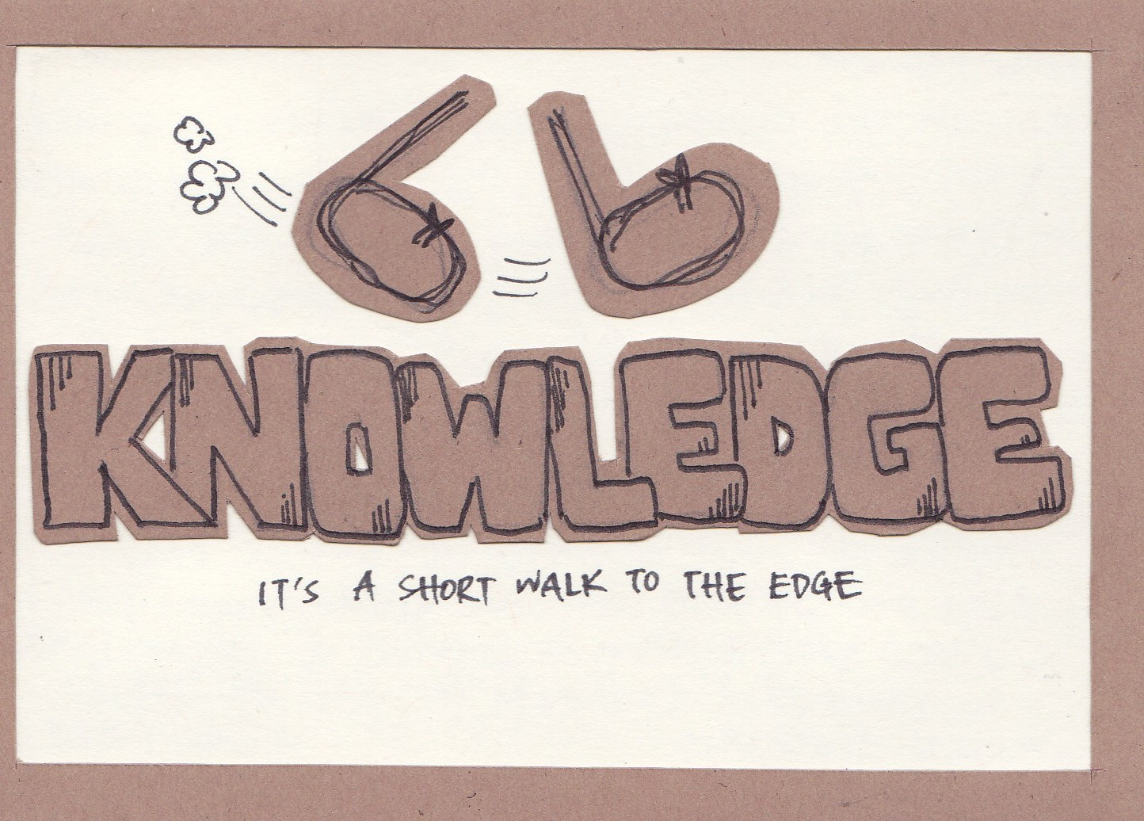

Slide 33
It is a short walk…
…to the edge of knowledge
There are significant knowledge gaps in every process that I will be teaching in this course
We aren’t able to optimize surface water treatment processes because we don’t yet understand the fundamental physics of many of the processes
We are getting closer…

